Slide 1
Electricity Tradeoffs

Slide 2
There are pros and cons to all power plant types
Each power plant has different:
CO₂ emissions
Costs
Other types of air pollution that cause health problems
Water impacts (amount used and pollution)
Land impacts
Amounts of electricity that it can produce

Slide 3
CO₂ Released

Slide 4
Electricity Produced
Today, the power plants in PA make about 225 terawatt-hours (TWh) of electricity each year.
A TWh is a measure of electricity use.
One TWh is a lot of electricity. In comparison, an average household in PA uses less than 0.001% of one TWh of electricity per year.

Slide 5
Environmental Impacts

Slide 6
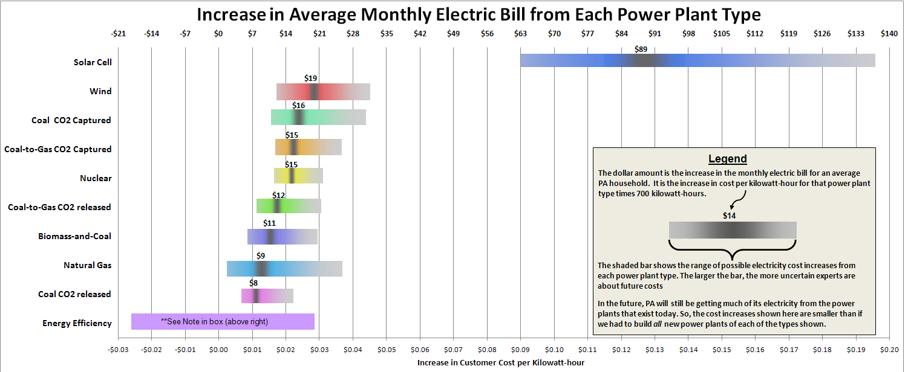
Cost Comparison
Average PA Household
pays $0.11 per kWh
uses 700 kWh per month
Average Monthly Electric Bill
$0.11 x 700 = $77
If your electric bill goes up by
$0.01 per kWh
uses 700 kWh per month
Increase in Monthly Electric Bill
$0.01 x 700 = $7
So, your total bill would be $77 + $7 = $84

Slide 7
WHAT IF….
U.S. Congress passed a law that PA had to reduce the amount of CO₂ released from all power plants built in the future
In the next 25 years, the demand for electricity will increase.
Existing power plants produce 225 TWh/year
New power plants will need to make an additional 60 TWh/year

Slide 8
The Original Plan
New Power Plant Construction
50% Coal
6 new coal plants = 30 TWh
35% Nuclear
3 new nuclear plants = 21 TWh
14% Natural Gas
4 new natural gas plants = 9 TWh
1% Wind
1 new wind farm = 0.5 TWh

Slide 9
The Original Plan
Electricity Produced: 60.2 TWh
CO₂ Released: 100%
Annual Water Use: 56,000 Olympic Pools
Land Use: 3,400 Football Fields
Annual Health Cost: $830 Million
Increase in Monthly Electric Bill: $8.35 or 11%
Increased cost of everything else you buy: 1%

Slide 10
Your Problem Question
Need power plants to make the additional 60 TWh of electricity for PA each year.
BUT: U.S. Congress requires that the combination of power plants you build will collectively need to release 50% less CO₂ than the original plan.
Your Task
Use computer tool to build a combination of new power plants that you think is the best.

Slide 11
Power Plant Combinations

Slide 12
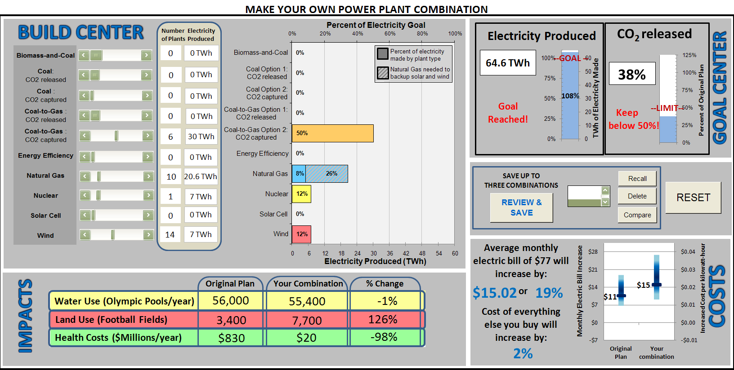
Computer Tool

Slide 13
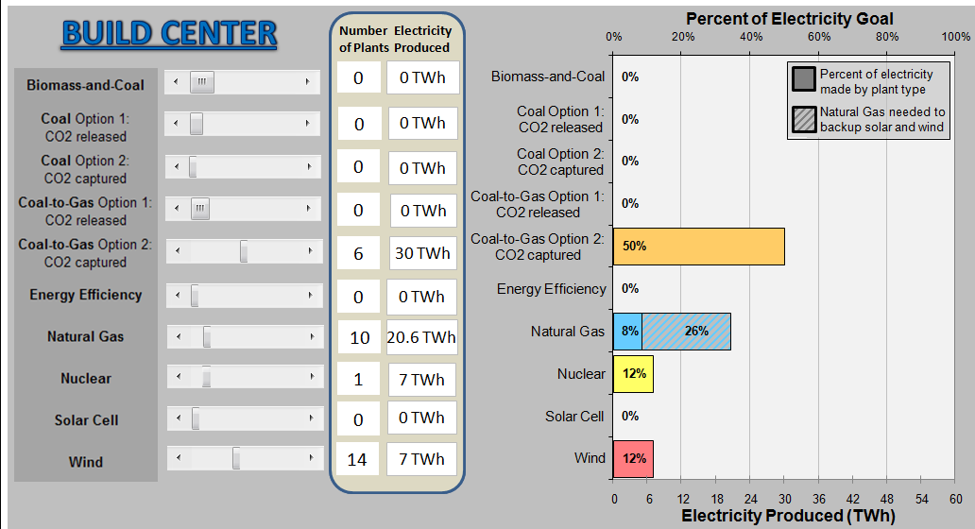
Build Center

Slide 14
Computer Tool

Slide 15
Goal Center

Slide 16
Computer Tool

Slide 17
Impacts

Slide 18
Computer Tool

Slide 19
Costs

Slide 20
Computer Tool

Slide 21
Controls

Slide 22
Controls

Slide 23
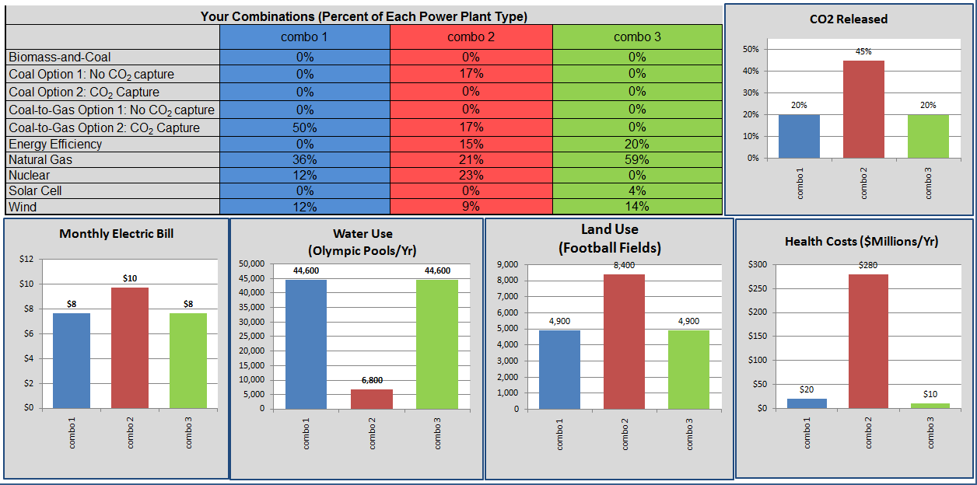
Compare

Slide 24
Teacher Guided Group Exercise
Explore the computer tool as a group to build a combination of power plants that you think is the best.
Goals:
Need power plants to make the additional 60 TWh of electricity for PA each year.
BUT: U.S. Congress requires that the combination of power plants you build will collectively need to release 50% less CO₂ than the original plan.

Slide 25
New Problem Question
Need power plants to make the additional 60 TWh of electricity for PA each year.
The original plan was to build these power plants:
6 Coal (Option 1) plants (50%)
4 natural gas (15% )
3 nuclear (35%)
1 wind farm (1%)
A new power plant combination will collectively need to release 50% less CO₂ than the original plan.
Your Task
Use computer tool to build a combination of new power plants that you think is the best.
The combination must make 60 TWh of electricity per year, but release 50% of the CO₂ that would have been released using the original plan.

Slide 26
Step-by-step exercise

